Slide 1

Variable Assignment

Slide 2
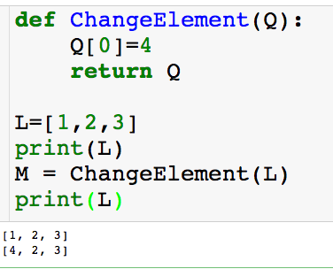
Back to Scope
Local scope:
Global scope:

Slide 3
Back to Scope
Local scope:
Global scope:

Slide 4
Back to Scope
Local scope:
Global scope:

Slide 5
Back to Scope
Local scope:
Global scope:

Slide 6
Back to Scope
Local scope:
Global scope:
Also will change L…huh???

Slide 7
Back to Scope
Local scope:
Global scope:

Slide 8
Back to Scope
Local scope:
Global scope:

Slide 9
Back to Scope
Local scope:
Global scope:

Slide 10
Back to Scope
Q: Why did a global variable get changed when I changed a local variables?

Slide 11
Back to Scope
Q: Why did a global variable get changed when I changed a local variables?
A: We have to better understand how variables are assigned in Python. We’ll come back to this example later.

Slide 12

Variable Assignment
a “points” to 3

Slide 13
Variable Assignment

Slide 14

Variable Assignment

Slide 15
Variable Assignment
Anytime you set a variable equal to a new object, its pointer will now point to the new object.

Slide 16
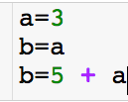
Variable Assignment

Slide 17
Variable Assignment

Slide 18
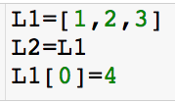
Variable Assignment

Slide 19
Variable Assignment

Slide 20
Variable Assignment

Slide 21
Variable Assignment
Both L1 and L2 are changed! Next, we’ll see how to correctly copy L1.

Slide 22
Back to Scope
Local scope:
Global scope:

Slide 23
Back to Scope
Local scope:
Global scope:

Slide 24
Back to Scope
Local scope:
Global scope:

Slide 25
Back to Scope
Local scope:
Global scope:

Slide 26
Back to Scope
Local scope:
Global scope:

Slide 27
Back to Scope
Local scope:
Global scope:

Slide 28
Back to Scope
Local scope:
Global scope:

Slide 29
Back to Scope
Local scope:
Global scope:

Slide 30
Back to Scope
Local scope:
Global scope:

Slide 31
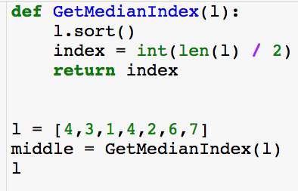
Example Where This Matters
Local scope:
Global scope:

Slide 32
Example Where This Matters
Local scope:
Global scope:

Slide 33
Example Where This Matters
Local scope:
Global scope:

Slide 34
Example Where This Matters
Local scope:
Global scope:

Slide 35
Example Where This Matters
Local scope:
Global scope:

Slide 36
Example Where This Matters
Local scope:
Global scope:

Slide 37
Example Where This Matters
Local scope:
Global scope:

Slide 38
Example Where This Matters
Local scope:
Global scope:

Slide 39
Example Where This Matters
Local scope:
Global scope:
Lost original ordering of l!

Slide 40
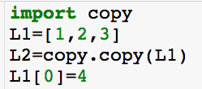
Copy

Slide 41
Copy

Slide 42
Copy

Slide 43
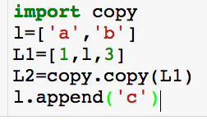
Copy

Slide 44
Copy

Slide 45
Copy

Slide 46
Copy

Slide 47
Copy
This changes l, L1 and L2 when maybe we only wanted l and L1 changed.

Slide 48
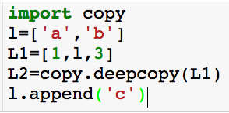
Deep Copy

Slide 49
Deep Copy

Slide 50
Deep Copy
This changes l, L1 and L2 when maybe we only wanted l and L1 changed.

Slide 51
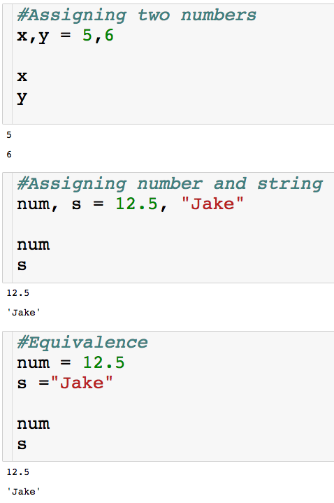
Assigning Multiple Variable

Slide 52
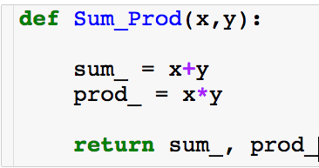
Returning Multiple Variables
There are two ways to collect what this function returns

Slide 53
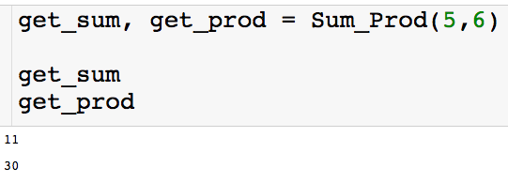
Returning Multiple Variables
There are two ways to collect what this function returns

Slide 54
Returning Multiple Variables
Order matters!
There are two ways to collect what this function returns

Slide 55
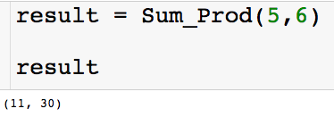
Returning Multiple Variables
There are two ways to collect what this function returns
result is a tuple

